Slide 1
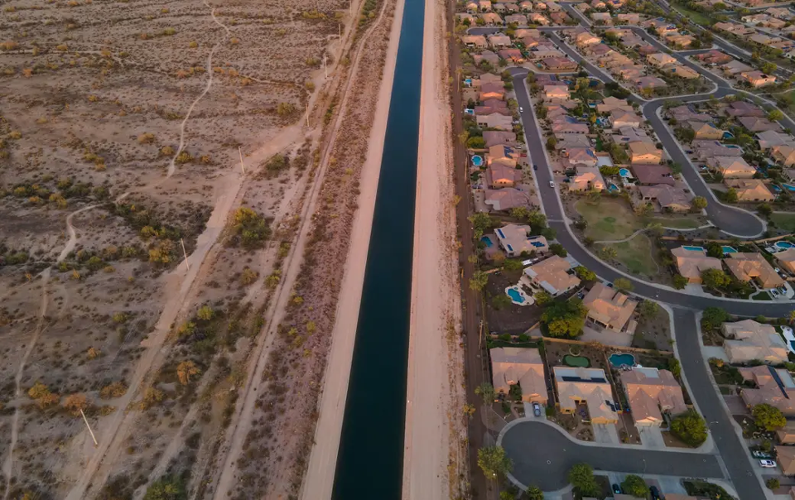
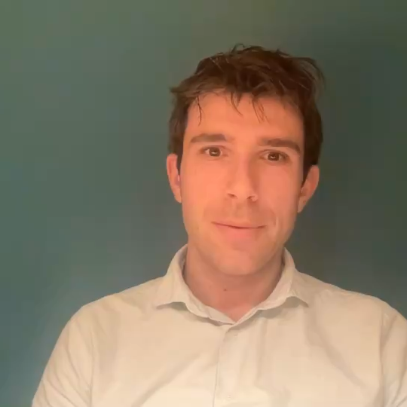

Impact of human water use on drought
More water use make us more vulnerable to drought
Sometimes humans have a reduce drought impacts
Niko Wanders
Universiteit Utrecht
Find me at xxxx

